Slide 1
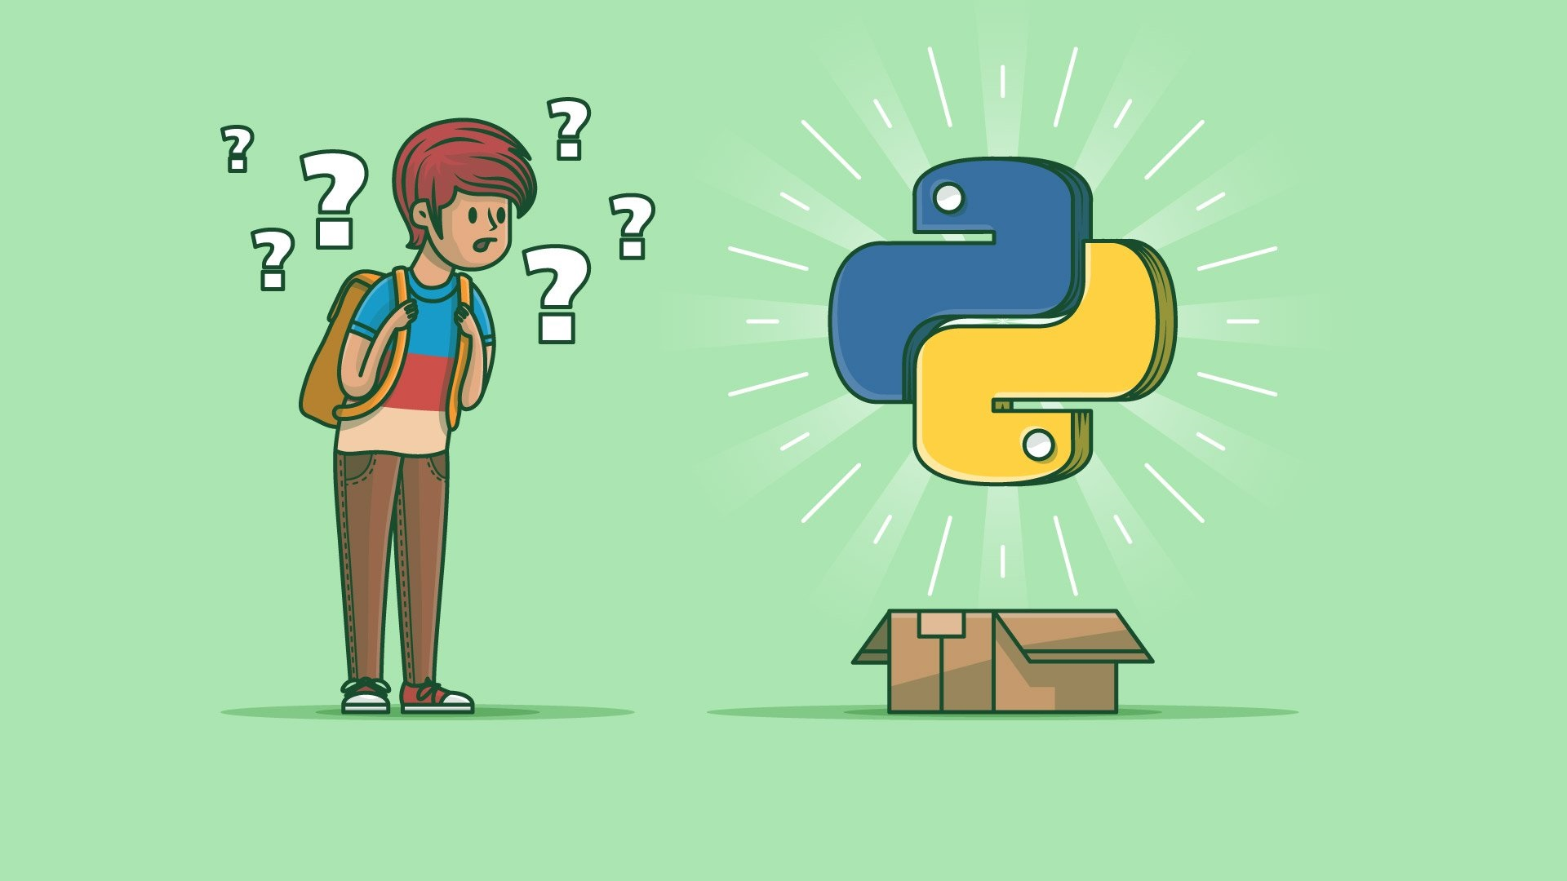
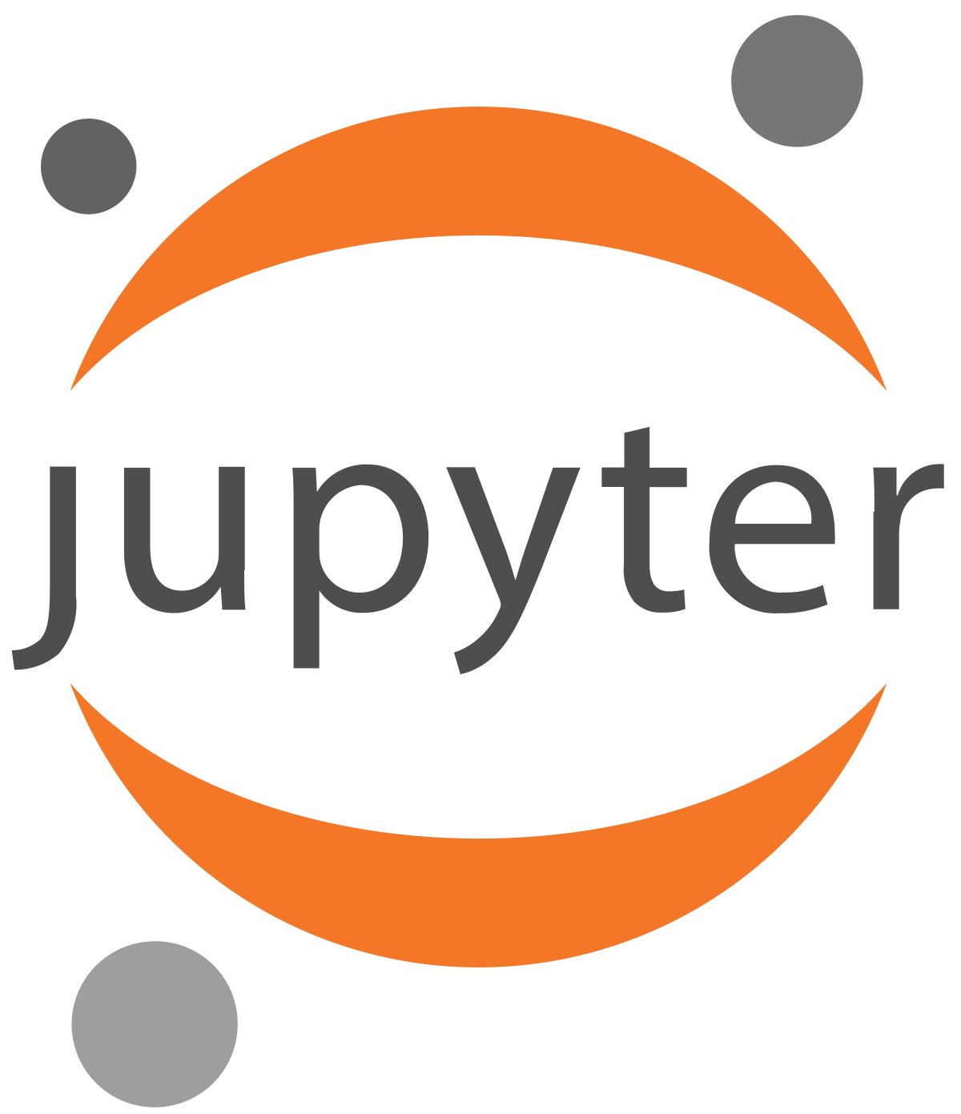

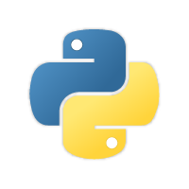
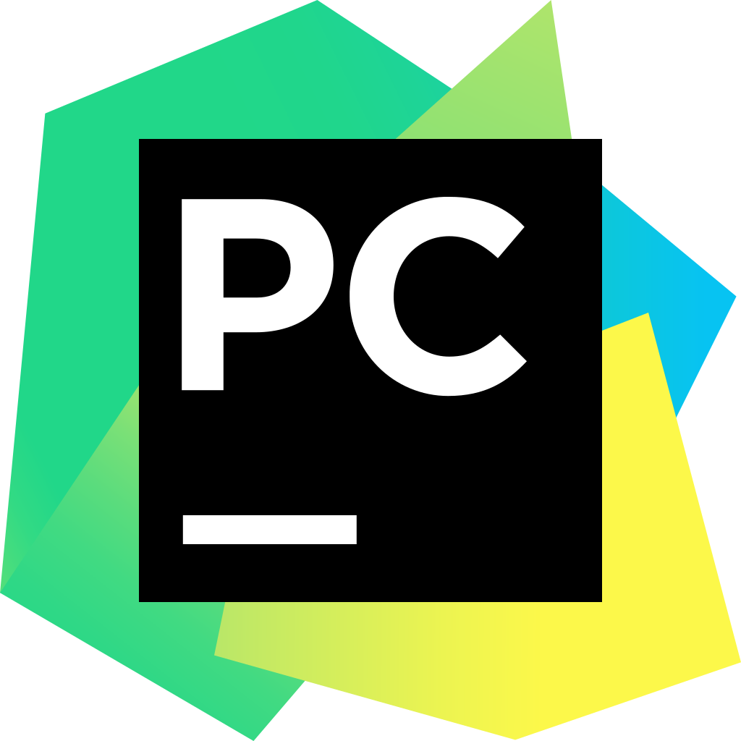


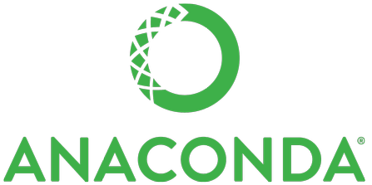
Installing
Python
Development
Environment

Slide 2
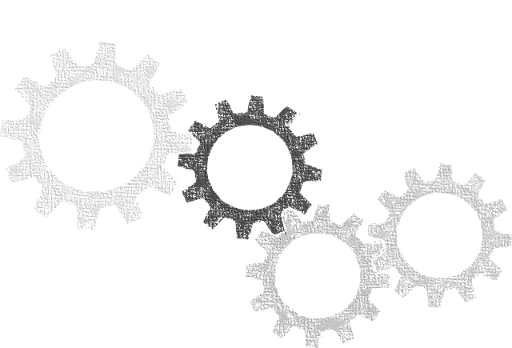
What is Compiler and Interpreter?
Every program is a set of instructions, whether it’s to add two numbers or send a request over the internet. Compilers and interpreters take human-readable code and convert it to computer-readable machine code.
using namespace std;
int main()
cout << "Hello World!" << endl;
return 0;
}
Compiler/Interpreter
0101111000110110100100111001001001000100100100010011111110000001111000011110101001111111001111111111100000111111111

Slide 3
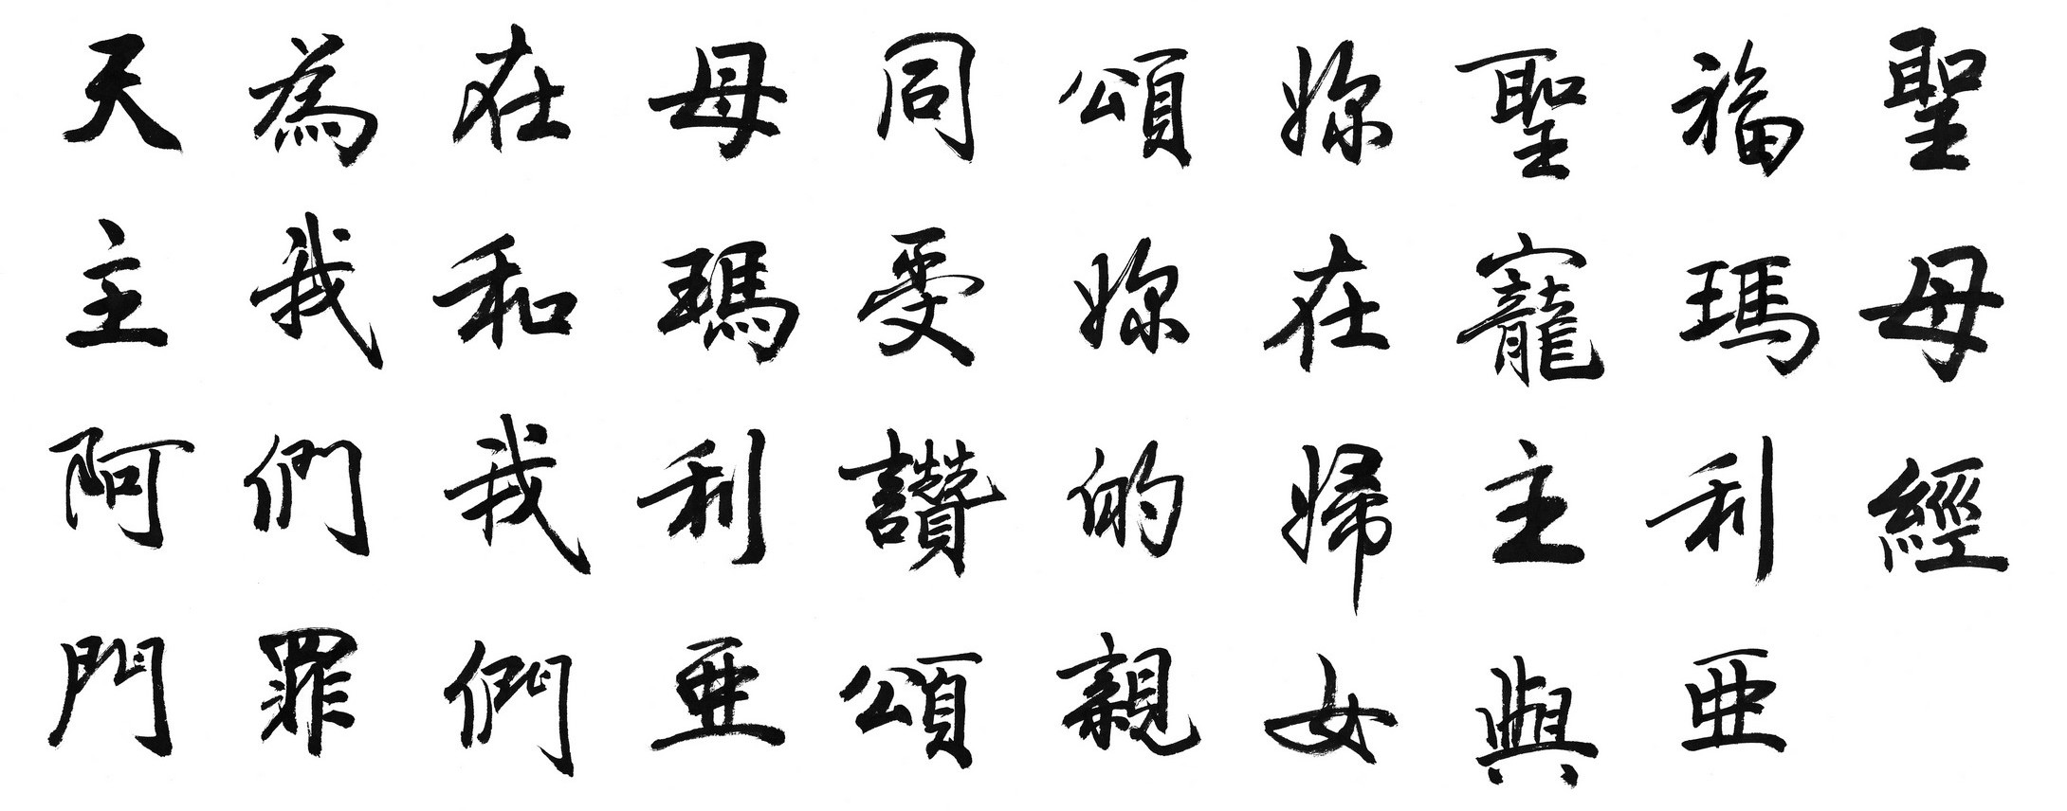


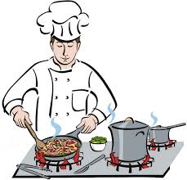
Interpreted vs Compiled Programming Languages:
What's the Difference?
Imagine you have a recipe that you want to make, but it's written in Chinese.
There are two ways you, a non chinese speaker, could follow its directions.
The first is if someone had already translated it into English for you.
You (and anyone else who can speak English) could read the English version
of the recipe and make the food. Think of this translated recipe as the compiled version.
Translation
The second way is if you have a friend who knows ancient Greek. When you're ready to make the food,
your friend sits next to you and translates the recipe into English as you go, line by line.
In this case, your friend is the interpreter for the interpreted version of the recipe.

Slide 4
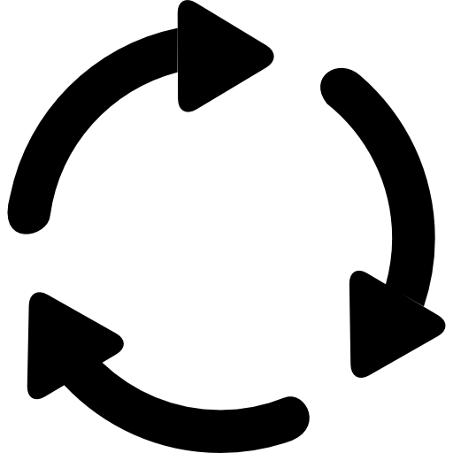

Compiled Languages
Examples of pure compiled languages are C, C++, Visual basic
Compiler
Execute
Faster
Private Code
00111010010101010111
Send
00111010010101010111
Not Cross- Platform
Inflexible
Interpreted Languages
Examples of interpreted languages are Python, Java script, Ruby and PHP.
Execute
Cross-Platform
Easy to Debug
Interpreter
Send a copy
Public Code
Slower

Slide 5

What else we need to start coding?
Compiler
Interpreter
Code Editor
Syntax Highlighting
Auto-Completion
Debugger
IDE
What is IDE?
Integrated Development Environment is a GUI where programmers write their code and produce final products

Slide 6
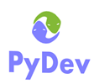
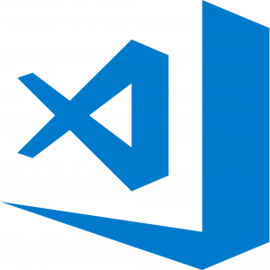


Python IDEs
IDLE
Spyder
PyDev
PyCharm
Jupyter Notebook
Visual Studio Code
SublimeText
ATOM
Thony

